Slide 1
User-Centered Design and Development
FJK 2005

Slide 2
Chapter 6
The Process of
Interaction Design

Slide 3
Chapter Overview
Interaction Design Activities
Key Characteristics of the Interaction Design Process
Users and User Needs
Alternative Designs
Life Cyle Models
FJK 2005

Slide 4
Motivation
it is helpful to know about common basic activities in interaction design, and key characteristics of the design process
interaction design should be driven by the needs of the users
alternative designs can provide options for users, designers, and developers
lifecycle models for interaction design have been derived from similar ones used in software engineering and HCI
FJK 2005

Slide 5
Objectives
know about the basic activities and key characteristics of the interaction design process
be aware of different types of users and shareholders, and their potential influence on the design
be familiar with some strategies to generate alternative designs
know the main differences between SE/HCI life cycle models and one for interaction design
FJK 2005

Slide 6

The Process of Interaction Design

Slide 7
Overview
What is Interaction Design?
Four basic activities
Three key characteristics
Some practical issues
Who are the users?
What are ‘needs’?
Where do alternatives come from?
How do you choose among alternatives?
Lifecycle models from software engineering
Lifecycle models from HCI

Slide 8
What is Interaction Design?
It is a process:
a goal-directed problem solving activity informed by intended use, target domain, materials, cost, and feasibility
a creative activity
a decision-making activity to balance trade-offs
It is a representation:
a plan for development
a set of alternatives and successive elaborations

Slide 9
Four Basic Activities
Identifying needs and establishing requirements
Developing alternative designs
Building interactive versions of the designs
prototypes
Evaluating designs

Slide 10
Three Key Characteristics
Three key characteristics permeate these four activities:
Focus on users early in the design and evaluation of the artefact
Identify, document and agree specific usability and user experience goals
Iteration is inevitable. Designers never get it right first time

Slide 11
Some Practical Issues
Who are the users?
What are ‘needs’?
Where do alternatives come from?
How do you choose among alternatives?

Slide 12
Who are the Users and Stakeholders?
Not as obvious as one may think:
those who interact directly with the product
those who manage direct users
those who receive output from the product
those who make the purchasing decision
those who use competitor’s products

Slide 13
Three Categories of Users
primary: frequent hands-on
secondary: occasional or via someone else
tertiaryالقطاع الثالث: affected by its introduction, or will influence its purchase
(Eason, 1987)

Slide 14
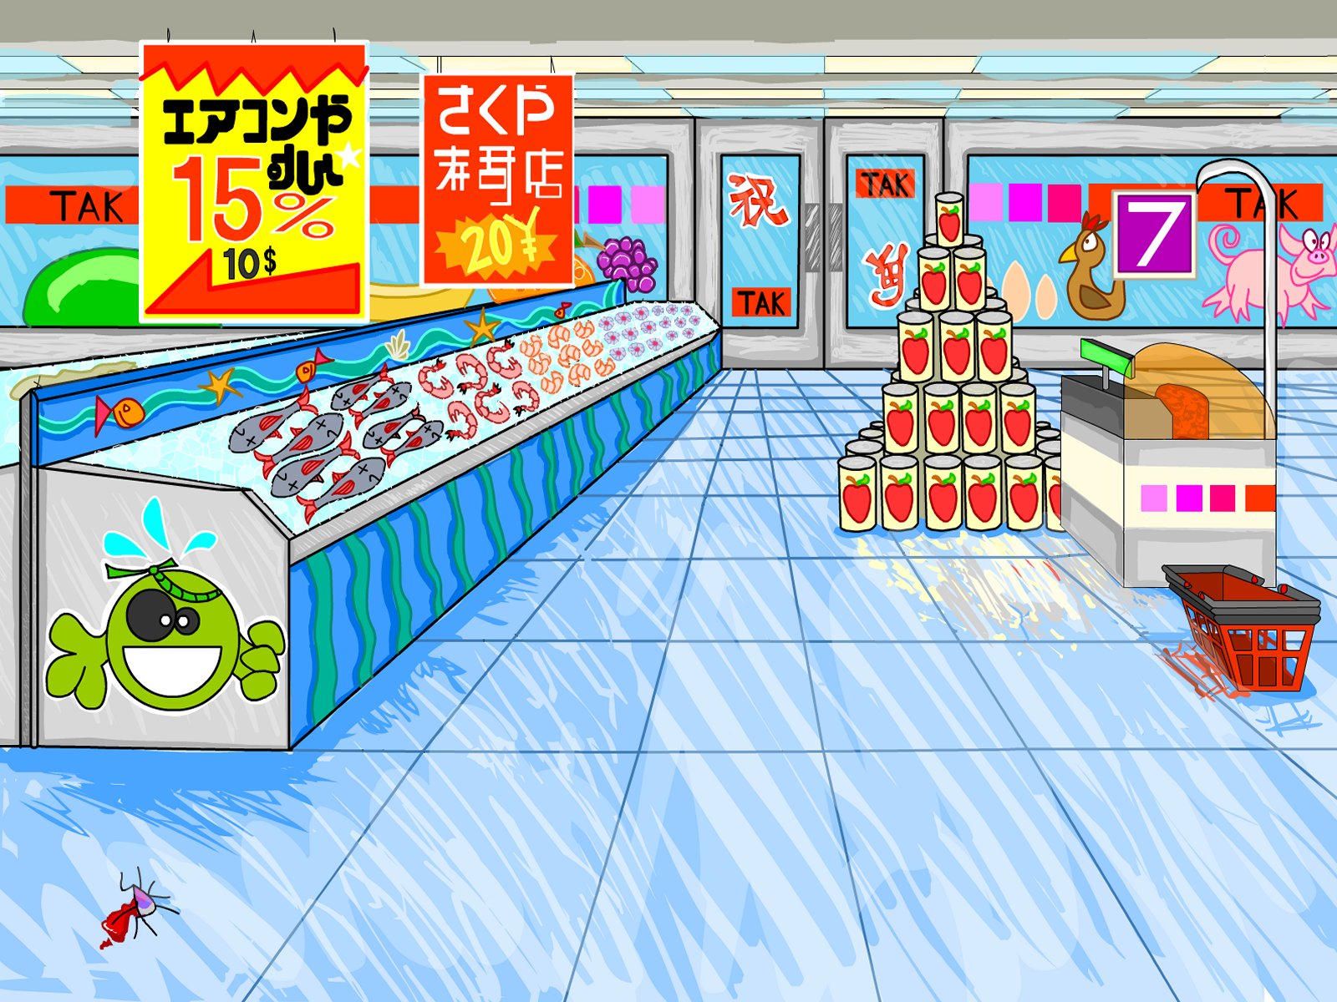
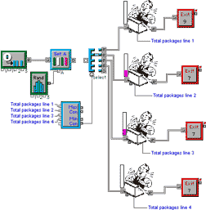
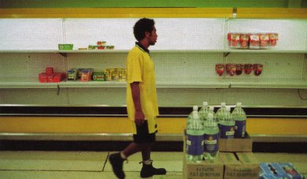
Who are the stakeholders?
Check-out operators
• Suppliers
• Local shop owners
Customers
Managers and owners

Slide 15


Users’ Capabilities
Humans vary in many dimensions:
size of hands may affect the size and positioning of input buttons
motor abilities may affect the suitability of certain input and output devices
height if designing a physical kiosk
strength - a child’s toy requires little strength to operate, but greater strength to change batteries
disabilities(e.g. sight, hearing, dexterity)

Slide 16
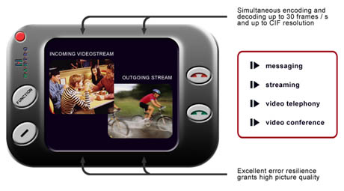
User Needs
Users rarely know what is possible
Users may not know their ‘needs’
to help them achieve their goals
Existing tasks:
their context
what information do they require?
who collaborates to achieve the task?
why is the task achieved the way it is?
Envisioned tasks:
can be rooted in existing behaviour
can be described as future scenarios

Slide 17
Design Alternatives
Humans stick to what they know works
But considering alternatives is important to ‘break out of the box’
Designers are trained to consider alternatives, software people generally are not
How do you generate alternatives?
‘Flair أسلوب and creativity’: research and synthesis
Seek inspiration: look at similar products or look at very different products

Slide 18
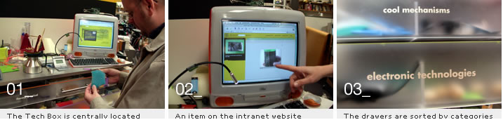
IDEO TechBox
Library, database, website - all-in-one
Contains physical gizmos for inspiration
From: www.ideo.com/

Slide 19
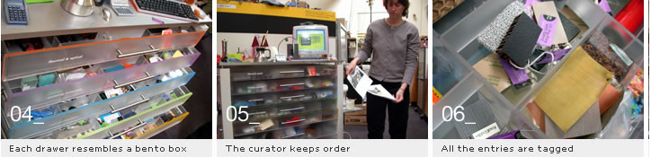
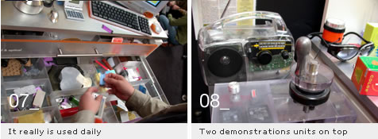
The TechBox

Slide 20
Choosing among Alternatives
Evaluation with users or with peers
prototypes
Technical feasibility
some alternatives are not possible/economical
Quality thresholds:
Usability goals lead to usability criteria set early on and check regularly
safety: how safe?
utility: which functions are superfluous?
effectiveness: appropriate support, task coverage, information available
efficiency: performance measurements

Slide 21
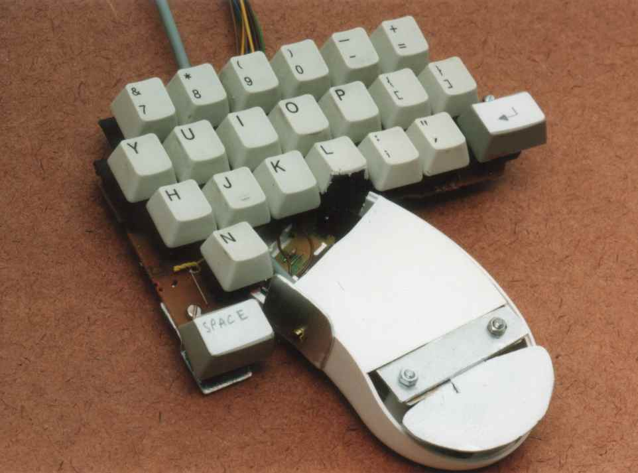
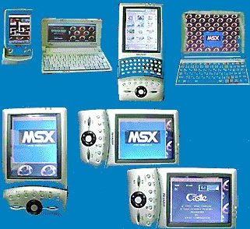
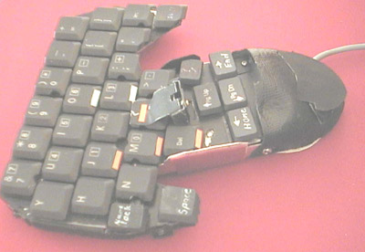
Testing Prototypes to choose among Alternatives

Slide 22
Lifecycle Models
Show how activities are related to each other
Lifecycle models are:
management tools
simplified versions of reality
Many lifecycle models exist, for example:
from software engineering: waterfall, spiral, JAD/RAD, Microsoft
from HCI: Star, usability engineering

Slide 23
A Simple Interaction Design Model
Identify needs/
establish
requirements
(Re)Design
Evaluate
Build an
interactive
version
Final product
Exemplifies a user-centered design approach

Slide 24
Traditional ‘Waterfall’ Lifecycle
Requirements analysis
Design
Code
Test
Maintenance

Slide 25
A Lifecycle for RAD (Rapid Applications Development)
Project set-up
JAD workshops
Iterative design and build
Engineer and
test final prototype
Implementation
review

Slide 26
Spiral Model (Barry Boehm)
Important features:
Risk analysis
Prototyping
Iterative framework allowing ideas to be checked and evaluated
Explicitly encourages alternatives to be considered
Good for large and complex projects but not simple ones
significant overhead

Slide 27
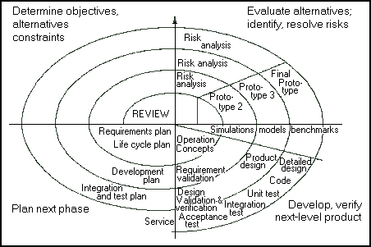
Spiral Lifecycle Model
From cctr.umkc.edu/~kennethjuwng/spiral.htm

Slide 28
The Star Lifecycle Model
Important features:
Evaluation at the center of activities
No particular ordering of activities. Development may start in any one
Derived from empirical studies of interface designers
Suggested by Hartson and Hix (1989)

Slide 29
The Star Model (Hartson and Hix, 1989)
Implementation
task/functional
analysis
Prototyping
Evaluation
Requirements
specification
Conceptual/
formal design
Notes:
UCD is a very general philosphy that instantiates itself in the context of a design project. Within HCI there have been many attempts to come up with actual life cycles where users are central. Examples include Rubinstein and Hersch successive iteration of 5 stages, info collecion, design, implementation, evaluation and deploment. The one here is taken fromHartson and Hix
model came about by analysing how design takes place in practice
evaluation is central: results of each ativity are evaluated before going onto next one
both bottom-up and top -down required in waves
software designers are familiar with this in their work and call it ‘yo-yoing’
it is important to do both structure and detail at the same time
in practice this is what is done - but the end result suggests otherwise corporate requirments dictate a top=down approach which is wha gets recorded
ch 5 of Developing User Interfaces (An Overview of Systems Analysis and Design) p- nice step-by-step methodology for doing user-centred design

Slide 30
Usability Engineering Lifecycle Model
Important features:
Holistic view of usability engineering
Provides links to software engineering approaches, e.g. OOSE
Stages of identifying requirements, designing, evaluating, prototyping
Can be scaled down for small projects
Uses a style guide to capture a set of usability goals
Reported by Deborah Mayhew

Slide 31
Summary
Four basic activities in the design process
Identify needs and establish requirements
Develop alternative designs
Building prototypes
Evaluating alternatives
Three characteristics
Involve users early in the design and evaluation of the artefact
Define quantifiable & measurable usability criteria
Iteration is inevitable
Lifecycle models show how these are related

